Slide 1

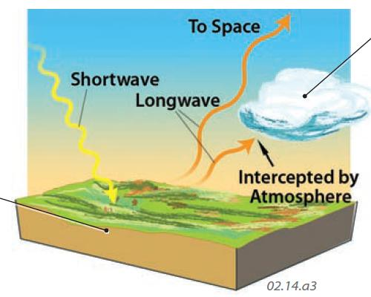
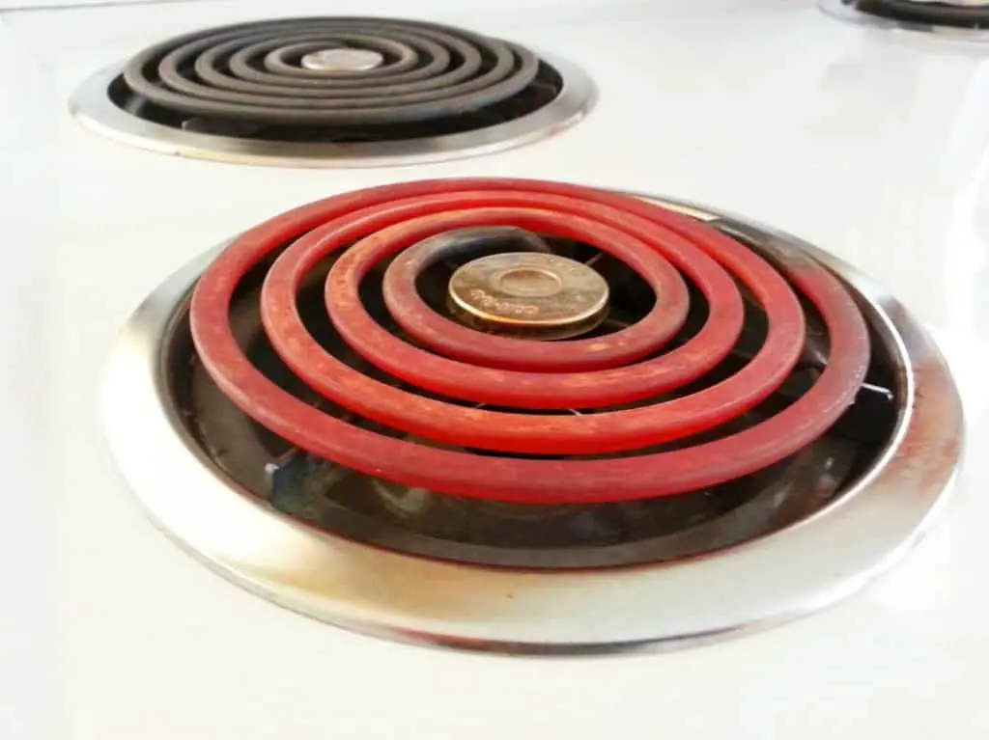
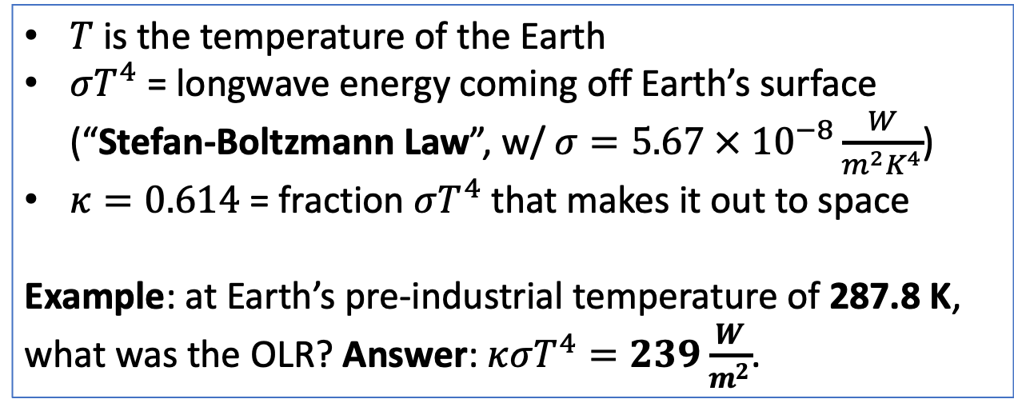
Remember the outgoing LW idea (which we’ll called OLR)
$T$ is the temperature of the Earth
$σT^{4}$ = longwave energy coming off Earth’s surface (“Stefan-Boltzmann Law”, w/ $σ=5.67 × {10}^{−8}\frac{W}{m^{2}K^{4}}$)
$κ=0.614$ = fraction $σT^{4}$ that makes it out to space
Example: at Earth’s pre-industrial temperature of 287.8 K, what was the OLR? Answer: $κσT^{4}=239\frac{W}{m^{2}}$.
The Stefan-Boltzmann law quantifies what you already know: a hot object emits more radiant heat than a cold object does.
$$T$$

Slide 2
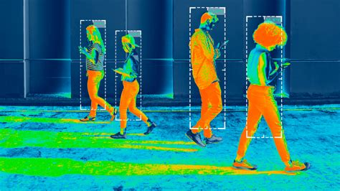
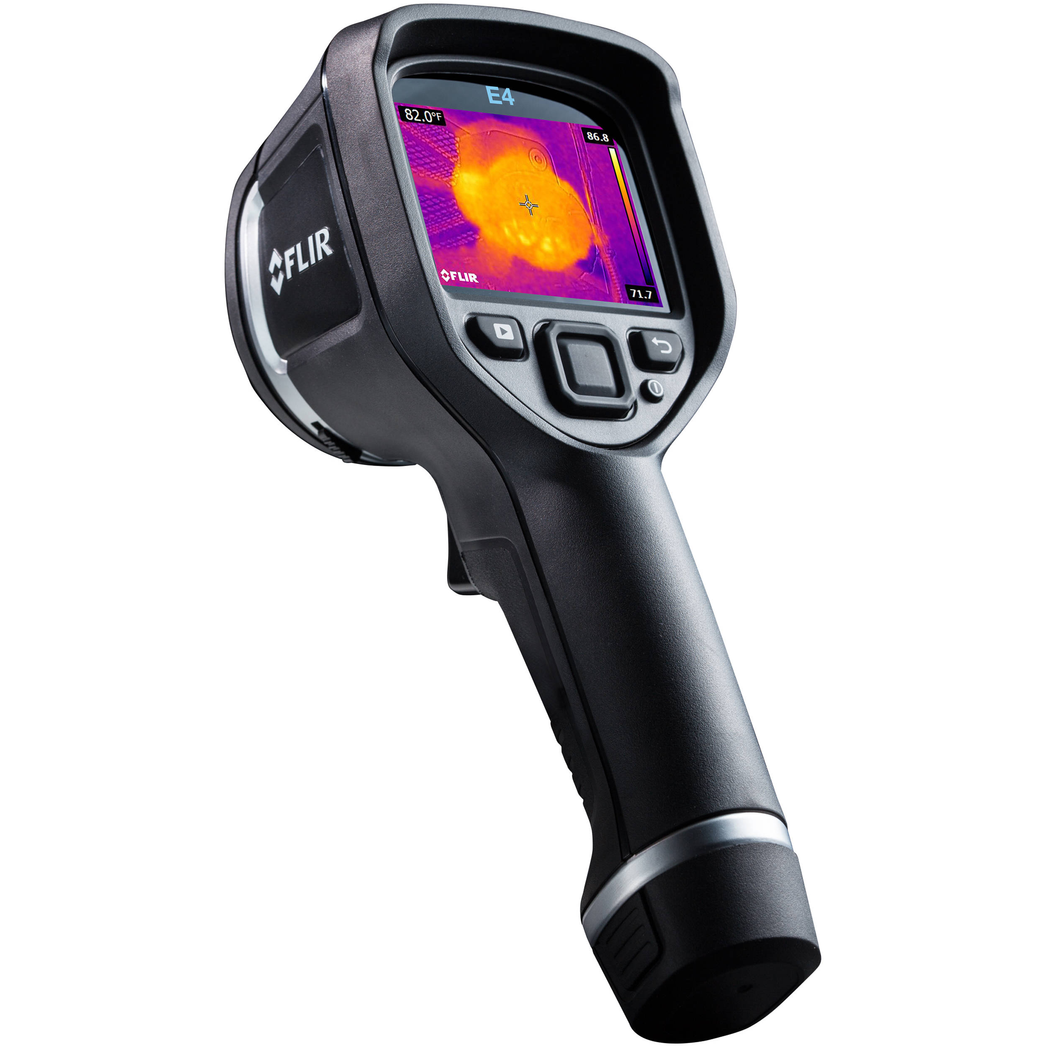
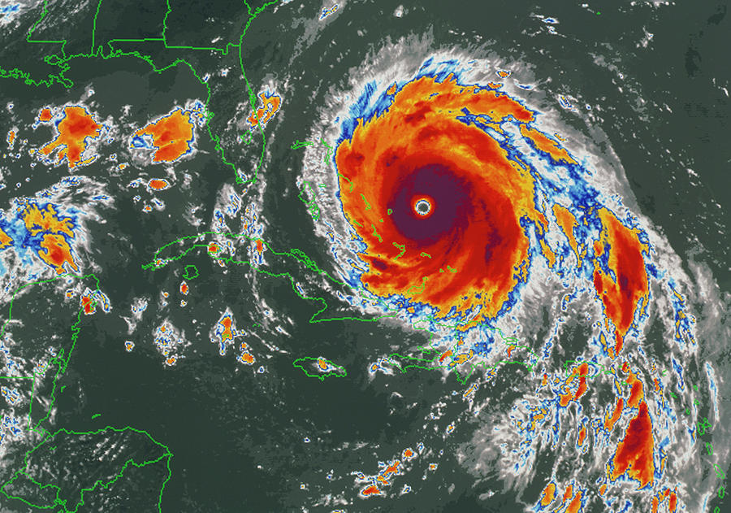
Remote sensing of temperature by IR (longwave light) detection
Image of Hurricane Floyd, taken on 13 September 1999 by the American NOAA-8 satellite.

Slide 3

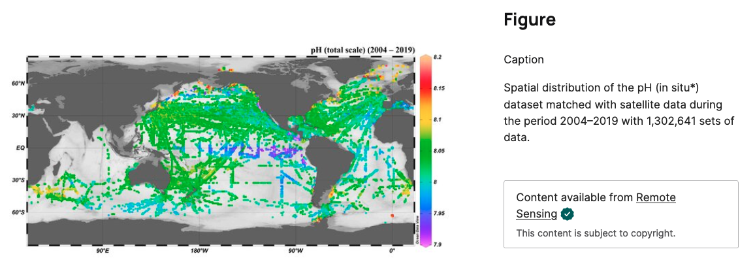
Remote sensing of ocean pH (an active area of climate research)

